Slide 1
Modeling Human Workload in Unmanned Arial Systems
Rovert Ivie, Jared Moore, Mike Goodrich, and Eric Mercer
Brigham Young University

Slide 2
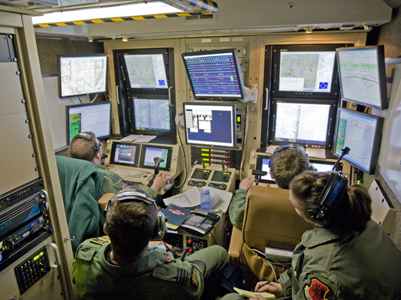

Slide 3
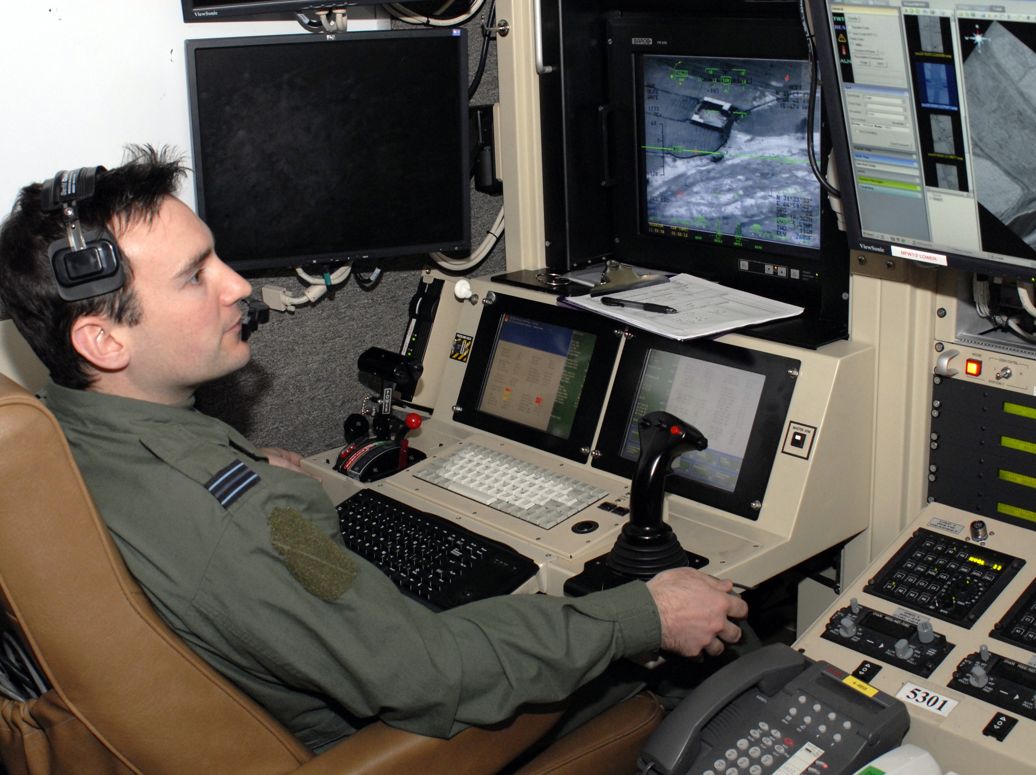

Slide 4
How can we reduce the number of operators and manage workload through better interfaces and increased autonomy?

Slide 5
Directed Team Graph
Visual
Bob
Audio
Alice
Visual
Audio
Notes:
Everything schedules on the event simulator.

Slide 6
Discrete Event Simulator
Visual
Bob
Audio
Alice
Visual
Audio
Events
Update on Event
Events
Discrete Event
Simulator
Notes:
Everything schedules on the event simulator.

Slide 7
Directed Role Graph
Memory
DESIRE = 10
Vo
Bob
Ao
c1
Vi
IDLE
WAVE
Ai
c2
c4
c3
SPEAK
Notes:
Everything schedules on the event simulator.

Slide 8
Tabular Form
PS | INPUT | MEM | NS | OUTPUT | MEM | Pr | Delay | Pb
IDLE |  | DESIRE>5 | WAVE | Vo=WAVE |  |  | [2-5] | 95%
IDLE |  | DESIRE<=5 | IDLE |  | DESIRE++ |  | [5-10]
WAVE | Vi=WAVE |  | SPEAK | Ao=HELLO | DESIRE++ | 1 | [2-5]
WAVE |  |  | IDLE | Vo=SAD | DESIRE-- | 2 | [5-10]
SPEAK | Ai=HELLO |  | IDLE |  | DESIRE-- |  | [2-5]
PS | INPUT | MEM | NS | OUTPUT | MEM | Pr | Delay | Pb
IDLE | Vi=WAVE | APATHY<5 | WAVE | Vo=WAVE |  |  | [2-5] | 70%
IDLE | Vi=WAVE | APATHY>=5 | IDLE |  | APATHY-- |  | [2-5]
WAVE | Ai=HELLO |  | IDLE | Ao=HELLO | APATHY++ | 1 | [2-5]
Notes:
Add non-determinism in the enabled events in each actor so they have a choice. That models decisions workload.
All enabled transitions are sent to the simulator. It resolves the choice on priority first, and the coin-flip if tie (or order of appearance in the table)’
If you post the same transition, then the simulator sticks with it. If you post a new transition, then the simulator replaces your scheduled transition with the new transition.
You can create models which loop infinitely without firing any transition (zeno or shrondingers cat problem)

Slide 9
DESIRE = 5
APATHY = 5
PS
IDLE
Bob
V_{o}
A_{o}
PS
IDLE
Alice
V_{o}
A_{o}
PS | INPUT | MEM | NS | OUTPUT | MEM | Pr | Delay | Pb
IDLE |  | DESIRE>5 | WAVE | Vo=WAVE |  |  | [2-5] | 95%
IDLE |  | DESIRE<=5 | IDLE |  | DESIRE++ |  | [5-10]

Slide 10
DESIRE = 5
APATHY = 5
PS
IDLE
IDLE
Bob
V_{o}
A_{o}
PS
IDLE
Alice
V_{o}
A_{o}
PS | INPUT | MEM | NS | OUTPUT | MEM | Pr | Delay | Pb
IDLE |  | DESIRE<=5 | IDLE |  | DESIRE++ |  | [5-10]

Slide 11
DESIRE = 5
APATHY = 5
PS
IDLE
IDLE
Bob
V_{o}
A_{o}
PS
IDLE
Alice
V_{o}
A_{o}
PS | INPUT | MEM | NS | OUTPUT | MEM | Pr | Delay | Pb
IDLE | Vi=WAVE | APATHY<5 | WAVE | Vo=WAVE |  |  | [2-5] | 70%
IDLE | Vi=WAVE | APATHY>=5 | IDLE |  | APATHY-- |  | [2-5]

Slide 12
DESIRE = 6
APATHY = 5
PS
IDLE
IDLE
Bob
V_{o}
A_{o}
PS
IDLE
Alice
V_{o}
A_{o}

Slide 13
DESIRE = 6
APATHY = 5
PS
IDLE
IDLE
Bob
V_{o}
A_{o}
PS
IDLE
Alice
V_{o}
A_{o}
PS | INPUT | MEM | NS | OUTPUT | MEM | Pr | Delay | Pb
IDLE |  | DESIRE>5 | WAVE | Vo=WAVE |  |  | [2-5] | 95%
IDLE |  | DESIRE<=5 | IDLE |  | DESIRE++ |  | [5-10]

Slide 14
DESIRE = 6
APATHY = 5
PS
IDLE
WAVE
Bob
V_{o}
WAVE
A_{o}
PS
IDLE
Alice
V_{o}
A_{o}
PS | INPUT | MEM | NS | OUTPUT | MEM | Pr | Delay | Pb
IDLE |  | DESIRE>5 | WAVE | Vo=WAVE |  |  | [2-5] | 95%

Slide 15
DESIRE = 6
APATHY = 5
PS
IDLE
WAVE
Bob
V_{o}
WAVE
A_{o}
PS
IDLE
Alice
V_{o}
A_{o}
PS | INPUT | MEM | NS | OUTPUT | MEM | Pr | Delay | Pb
IDLE | Vi=WAVE | APATHY<5 | WAVE | Vo=WAVE |  |  | [2-5] | 70%
IDLE | Vi=WAVE | APATHY>=5 | IDLE |  | APATHY-- |  | [2-5]

Slide 16
DESIRE = 6
APATHY = 5
PS
IDLE
WAVE
Bob
V_{o}
WAVE
A_{o}
PS
IDLE
Alice
V_{o}
A_{o}

Slide 17
DESIRE = 6
APATHY = 5
PS
IDLE
WAVE
Bob
V_{o}
WAVE
A_{o}
PS
IDLE
Alice
V_{o}
A_{o}
PS | INPUT | MEM | NS | OUTPUT | MEM | Pr | Delay | Pb
WAVE | Vi=WAVE |  | SPEAK | Ao=HELLO | DESIRE++ | 1 | [2-5]
WAVE |  |  | IDLE | Vo=SAD | DESIRE-- | 2 | [5-10]

Slide 18
DESIRE = 6
APATHY = 5
PS
IDLE
WAVE
IDLE
Bob
V_{o}
WAVE
SAD
A_{o}
PS
IDLE
Alice
V_{o}
A_{o}
PS | INPUT | MEM | NS | OUTPUT | MEM | Pr | Delay | Pb
WAVE | Vi=WAVE |  | SPEAK | Ao=HELLO | DESIRE++ | 1 | [2-5]
WAVE |  |  | IDLE | Vo=SAD | DESIRE-- | 2 | [5-10]

Slide 19
DESIRE = 6
APATHY = 5
PS
IDLE
WAVE
IDLE
Bob
V_{o}
WAVE
SAD
A_{o}
PS
IDLE
Alice
V_{o}
A_{o}
PS | INPUT | MEM | NS | OUTPUT | MEM | Pr | Delay | Pb
IDLE | Vi=WAVE | APATHY<5 | WAVE | Vo=WAVE |  |  | [2-5] | 70%
IDLE | Vi=WAVE | APATHY>=5 | IDLE |  | APATHY-- |  | [2-5]

Slide 20
DESIRE = 6
APATHY = 5
PS
IDLE
WAVE
IDLE
Bob
V_{o}
WAVE
SAD
A_{o}
PS
IDLE
IDLE
Alice
V_{o}
A_{o}
PS | INPUT | MEM | NS | OUTPUT | MEM | Pr | Delay | Pb
IDLE | Vi=WAVE | APATHY<5 | WAVE | Vo=WAVE |  |  | [2-5] | 70%
IDLE | Vi=WAVE | APATHY>=5 | IDLE |  | APATHY-- |  | [2-5]

Slide 21
DESIRE = 6
APATHY = 4
PS
IDLE
WAVE
IDLE
Bob
V_{o}
WAVE
SAD
A_{o}
PS
IDLE
IDLE
Alice
V_{o}
A_{o}

Slide 22
DESIRE = 6
APATHY = 4
PS
IDLE
WAVE
IDLE
Bob
V_{o}
WAVE
SAD
A_{o}
PS
IDLE
IDLE
Alice
V_{o}
A_{o}
PS | INPUT | MEM | NS | OUTPUT | MEM | Pr | Delay | Pb
WAVE | Vi=WAVE |  | SPEAK | Ao=HELLO | DESIRE++ | 1 | [2-5]
WAVE |  |  | IDLE | Vo=SAD | DESIRE-- | 2 | [5-10]

Slide 23
DESIRE = 6
APATHY = 4
PS
IDLE
WAVE
IDLE
Bob
V_{o}
WAVE
SAD
A_{o}
PS
IDLE
IDLE
Alice
V_{o}
A_{o}
PS | INPUT | MEM | NS | OUTPUT | MEM | Pr | Delay | Pb
IDLE | Vi=WAVE | APATHY<5 | WAVE | Vo=WAVE |  |  | [2-5] | 70%
IDLE | Vi=WAVE | APATHY>=5 | IDLE |  | APATHY-- |  | [2-5]

Slide 24
DESIRE = 6
APATHY = 4
PS
IDLE
WAVE
IDLE
Bob
V_{o}
WAVE
SAD
A_{o}
PS
IDLE
WAVE
Alice
V_{o}
WAVE
A_{o}
PS | INPUT | MEM | NS | OUTPUT | MEM | Pr | Delay | Pb
IDLE | Vi=WAVE | APATHY<5 | WAVE | Vo=WAVE |  |  | [2-5] | 70%
IDLE | Vi=WAVE | APATHY>=5 | IDLE |  | APATHY-- |  | [2-5]

Slide 25
DESIRE = 6
APATHY = 4
PS
IDLE
WAVE
IDLE
Bob
V_{o}
WAVE
SAD
A_{o}
PS
IDLE
WAVE
Alice
V_{o}
WAVE
A_{o}

Slide 26
DESIRE = 6
APATHY = 4
PS
IDLE
WAVE
IDLE
Bob
V_{o}
WAVE
SAD
A_{o}
PS
IDLE
WAVE
Alice
V_{o}
WAVE
A_{o}
PS | INPUT | MEM | NS | OUTPUT | MEM | Pr | Delay | Pb
WAVE | Vi=WAVE |  | SPEAK | Ao=HELLO | DESIRE++ | 1 | [2-5]
WAVE |  |  | IDLE | Vo=SAD | DESIRE-- | 2 | [5-10]

Slide 27
DESIRE = 6
APATHY = 4
PS
IDLE
WAVE
SPEAK
Bob
V_{o}
WAVE
A_{o}
HELLO
PS
IDLE
WAVE
Alice
V_{o}
WAVE
A_{o}
PS | INPUT | MEM | NS | OUTPUT | MEM | Pr | Delay | Pb
WAVE | Vi=WAVE |  | SPEAK | Ao=HELLO | DESIRE++ | 1 | [2-5]
WAVE |  |  | IDLE | Vo=SAD | DESIRE-- | 2 | [5-10]

Slide 28
DESIRE = 6
APATHY = 4
PS
IDLE
WAVE
SPEAK
Bob
V_{o}
WAVE
A_{o}
HELLO
PS
IDLE
WAVE
Alice
V_{o}
WAVE
A_{o}
PS | INPUT | MEM | NS | OUTPUT | MEM | Pr | Delay | Pb
WAVE | Ai=HELLO |  | IDLE | Ao=HELLO | APATHY++ | 1 | [2-5]

Slide 29
DESIRE = 6
APATHY = 4
PS
IDLE
WAVE
SPEAK
Bob
V_{o}
WAVE
A_{o}
HELLO
PS
IDLE
WA
Alice
V_{o}
WA
A_{o}

Slide 30
DESIRE = 6
APATHY = 4
PS
IDLE
WAVE
SPEAK
Bob
V_{o}
WAVE
A_{o}
HELLO
PS
IDLE
WA
Alice
V_{o}
WA
A_{o}
PS | INPUT | MEM | NS | OUTPUT | MEM | Pr | Delay | Pb
SPEAK | Ai=HELLO |  | IDLE |  | DESIRE-- |  | [2-5]

Slide 31
DESIRE = 6
APATHY = 4
PS
IDLE
WAVE
SPEAK
Bob
V_{o}
WAVE
A_{o}
HELLO
PS
IDLE
WA
Alice
V_{o}
WA
A_{o}
PS | INPUT | MEM | NS | OUTPUT | MEM | Pr | Delay | Pb
WAVE | Ai=HELLO |  | IDLE | Ao=HELLO | APATHY++ | 1 | [2-5]

Slide 32
DESIRE = 6
APATHY = 4
PS
IDLE
WAVE
SPEAK
Bob
V_{o}
WAVE
A_{o}
HELLO
PS
IDLE
WAVE
IDLE
Alice
V_{o}
WAVE
A_{o}
HELLO
PS | INPUT | MEM | NS | OUTPUT | MEM | Pr | Delay | Pb
WAVE | Ai=HELLO |  | IDLE | Ao=HELLO | APATHY++ | 1 | [2-5]

Slide 33
DESIRE = 6
APATHY = 5
PS
IDLE
WAVE
SPEAK
Bob
V_{o}
WAVE
A_{o}
HELLO
PS
IDLE
WAVE
IDLE
Alice
V_{o}
WAVE
A_{o}
HELLO

Slide 34
DESIRE = 6
APATHY = 5
PS
IDLE
WAVE
SPEAK
Bob
V_{o}
WAVE
A_{o}
HELLO
PS
IDLE
WAVE
IDLE
Alice
V_{o}
WAVE
A_{o}
HELLO
PS | INPUT | MEM | NS | OUTPUT | MEM | Pr | Delay | Pb
SPEAK | Ai=HELLO |  | IDLE |  | DESIRE-- |  | [2-5]

Slide 35
DESIRE = 6
APATHY = 5
PS
IDLE
WAVE
SPEAK
IDLE
Bob
V_{o}
WAVE
A_{o}
HELLO
PS
IDLE
WAVE
IDLE
Alice
V_{o}
WAVE
A_{o}
HELLO
PS | INPUT | MEM | NS | OUTPUT | MEM | Pr | Delay | Pb
SPEAK | Ai=HELLO |  | IDLE |  | DESIRE-- |  | [2-5]

Slide 36
DESIRE = 6
APATHY = 5
PS
IDLE
WAVE
SPEAK
IDLE
Bob
V_{o}
WAVE
A_{o}
HELLO
PS
IDLE
WAVE
IDLE
Alice
V_{o}
WAVE
A_{o}
HELLO
PS | INPUT | MEM | NS | OUTPUT | MEM | Pr | Delay | Pb
IDLE | Vi=WAVE | APATHY<5 | WAVE | Vo=WAVE |  |  | [2-5] | 70%
IDLE | Vi=WAVE | APATHY>=5 | IDLE |  | APATHY-- |  | [2-5]

Slide 37
DESIRE = 5
APATHY = 5
PS
IDLE
WAVE
SPEAK
IDLE
Bob
V_{o}
WAVE
A_{o}
HELLO
PS
IDLE
WAVE
IDLE
Alice
V_{o}
WAVE
A_{o}
HELLO

Slide 38
Workload
Temporal
Perceptual
Cognitive

Slide 39
Workload
Temporal
Perceptual
Cognitive
Notes:
Metaphor: job shop
Constraints: order, which comes first, deadlines
Operation Tempo: pacing and completion of tasks over time
Fan-out: task neglect and required interaction time

Slide 40
Temporal Workload in Model
PS
IDLE
WAVE
SPEAK
Bob
V_{o}
WAVE
A_{o}
HELLO
PS
IDLE
WAVE
IDLE
Alice
V_{o}
WAVE
A_{o}
HELLO
6 fired transitions
Notes:
Largely a measure of operation tempo: Sliding window that counts transitions

Slide 41
Temporal Workload in Model
PS
IDLE
WAVE
SPEAK
Bob
V_{o}
WAVE
A_{o}
HELLO
PS
IDLE
WAVE
IDLE
Alice
V_{o}
WAVE
A_{o}
HELLO
4 fired transitions
Notes:
Largely a measure of operation tempo: Sliding window that counts transitions

Slide 42
Temporal Workload in Model
PS
IDLE
WAVE
SPEAK
Bob
V_{o}
WAVE
A_{o}
HELLO
PS
IDLE
WAVE
IDLE
Alice
V_{o}
WAVE
A_{o}
HELLO
4 fired transitions
Notes:
Largely a measure of operation tempo: Sliding window that counts transitions

Slide 43
Temporal Workload in Model
PS
IDLE
WAVE
SPEAK
Bob
V_{o}
WAVE
A_{o}
HELLO
PS
IDLE
WAVE
IDLE
Alice
V_{o}
WAVE
A_{o}
HELLO
6 fired transitions
Notes:
Largely a measure of operation tempo: Sliding window that counts transitions

Slide 44
Temporal Workload in Model
PS
IDLE
WAVE
SPEAK
Bob
V_{o}
WAVE
A_{o}
HELLO
PS
IDLE
WAVE
IDLE
Alice
V_{o}
WAVE
A_{o}
HELLO
6 fired transitions
Notes:
Largely a measure of operation tempo: Sliding window that counts transitions

Slide 45
Temporal Workload in Model
PS
IDLE
WAVE
SPEAK
Bob
V_{o}
WAVE
A_{o}
HELLO
PS
IDLE
WAVE
IDLE
Alice
V_{o}
WAVE
A_{o}
HELLO
6 fired transitions
Notes:
Largely a measure of operation tempo: Sliding window that counts transitions

Slide 46
Temporal Workload in Model
PS
IDLE
WAVE
SPEAK
Bob
V_{o}
WAVE
A_{o}
HELLO
PS
IDLE
WAVE
IDLE
Alice
V_{o}
WAVE
A_{o}
HELLO
8 fired transitions
Notes:
Largely a measure of operation tempo: Sliding window that counts transitions

Slide 47
Workload
Temporal
Perceptual
Cognitive
Notes:
Metaphor: computer hardware
Parallel: Using multiple channels simultaneously such as visual and audio. Or visual, audio, and haptic.
Sequential: Doing one thing at a time in series.
Multi-threaded: Channel conflict—two audio sources both active

Slide 48
Cognitive Workload in Model
PS
IDLE
WAVE
SPEAK
Bob
V_{o}
WAVE
A_{o}
HELLO
PS
IDLE
WAVE
IDLE
Alice
V_{o}
WAVE
A_{o}
HELLO
0 Active Inputs
Notes:
Count the number of active inputs at each point in time (every output is an input somewhere). Only count at the interface of certain actors.

Slide 49
Cognitive Workload in Model
PS
IDLE
WAVE
SPEAK
Bob
V_{o}
WAVE
A_{o}
HELLO
PS
IDLE
WAVE
IDLE
Alice
V_{o}
WAVE
A_{o}
HELLO
1 Active Inputs

Slide 50
Cognitive Workload in Model
PS
IDLE
WAVE
SPEAK
Bob
V_{o}
WAVE
A_{o}
HELLO
PS
IDLE
WAVE
IDLE
Alice
V_{o}
WAVE
A_{o}
HELLO
1 Active Inputs

Slide 51
Cognitive Workload in Model
PS
IDLE
WAVE
SPEAK
Bob
V_{o}
WAVE
A_{o}
HELLO
PS
IDLE
WAVE
IDLE
Alice
V_{o}
WAVE
A_{o}
HELLO
1 Active Inputs

Slide 52
Cognitive Workload in Model
PS
IDLE
WAVE
SPEAK
Bob
V_{o}
WAVE
A_{o}
HELLO
PS
IDLE
WAVE
IDLE
Alice
V_{o}
WAVE
A_{o}
HELLO
1 Active Inputs

Slide 53
Cognitive Workload in Model
PS
IDLE
WAVE
SPEAK
Bob
V_{o}
WAVE
A_{o}
HELLO
PS
IDLE
WAVE
IDLE
Alice
V_{o}
WAVE
A_{o}
HELLO
1 Active Inputs

Slide 54
Cognitive Workload in Model
PS
IDLE
WAVE
SPEAK
Bob
V_{o}
WAVE
A_{o}
HELLO
PS
IDLE
WAVE
IDLE
Alice
V_{o}
WAVE
A_{o}
HELLO
2 Active Inputs

Slide 55
Cognitive Workload in Model
PS
IDLE
WAVE
SPEAK
Bob
V_{o}
WAVE
A_{o}
HELLO
PS
IDLE
WAVE
IDLE
Alice
V_{o}
WAVE
A_{o}
HELLO
2 Active Inputs

Slide 56
Workload
Temporal
Perceptual
Cognitive
Notes:
Metaphor: artificial intelligence
Perceive, think, act: finding the solution is often harder than executing the solution (perceive and think matter)
Algorithmic Complexity: Executing the solution may take time.

Slide 57
Algorithmic Workload in Model
PS
IDLE
WAVE
SPEAK
IDLE
Bob
V_{o}
WAVE
A_{o}
HELLO
PS
IDLE
WAVE
IDLE
Alice
V_{o}
WAVE
A_{o}
PS | INPUT | MEM | NS | OUTPUT | MEM | Pr | Delay | Pb
IDLE | Ai=HELLO |  | SPEAK | Vo=WAVE |  |  | [2-5] | 70%
IDLE | Ai=HELLO |  | IDLE |  | APATHY-- |  | [2-5]
2 Enabled Transitions
Notes:
Abstracts Perceive. There are two choices. A little strange all the same though since the simulator makes the final selection (randomly) when it is not resolved by priority.

Slide 58
Algorithmic Workload in Model
PS
IDLE
IDLE
Bob
V_{o}
A_{o}
PS
IDLE
Alice
V_{o}
A_{o}
Working over 5 time units
Nothing Fired
Notes:
Crude abstraction of algorithmic complexity. It took some amount of time to be ready to fire a transition.
Increment a counter in each time bucket if an actor is working. Otherwise leave it alone.
Must measure per-actor back from fired transition over the duration.

Slide 59
Algorithmic Workload in Model
PS
IDLE
WAVE
Bob
V_{o}
WAVE
A_{o}
PS
IDLE
Alice
V_{o}
A_{o}
Working over 2 time units
Nothing Fired
Notes:
Crude abstraction of algorithmic complexity. It took some amount of time to be ready to fire a transition.

Slide 60
Algorithmic Workload in Model
PS
IDLE
WAVE
IDLE
Bob
V_{o}
WAVE
SAD
A_{o}
PS
IDLE
IDLE
Alice
V_{o}
A_{o}
Nothing Fired
Working over 3 time units
Notes:
It is a causal relationship.

Slide 61
Algorithmic Workload in Model
PS
IDLE
WAVE
IDLE
Bob
V_{o}
WAVE
SAD
A_{o}
PS
IDLE
WAVE
Alice
V_{o}
WAVE
A_{o}
Nothing Fired
Working over 2 time units
Notes:
Once a transition fires, it looks back and marks where it was working.

Slide 62
Resolving Non-determinism
Many Executions
Java Pathfinder
Non-Deterministic Model

Slide 63
Finding Workload Extremes
Instantaneous
Workload
Cumulative Workload
Time
Find Paths that Max/Min Cumulative Workload

Slide 64
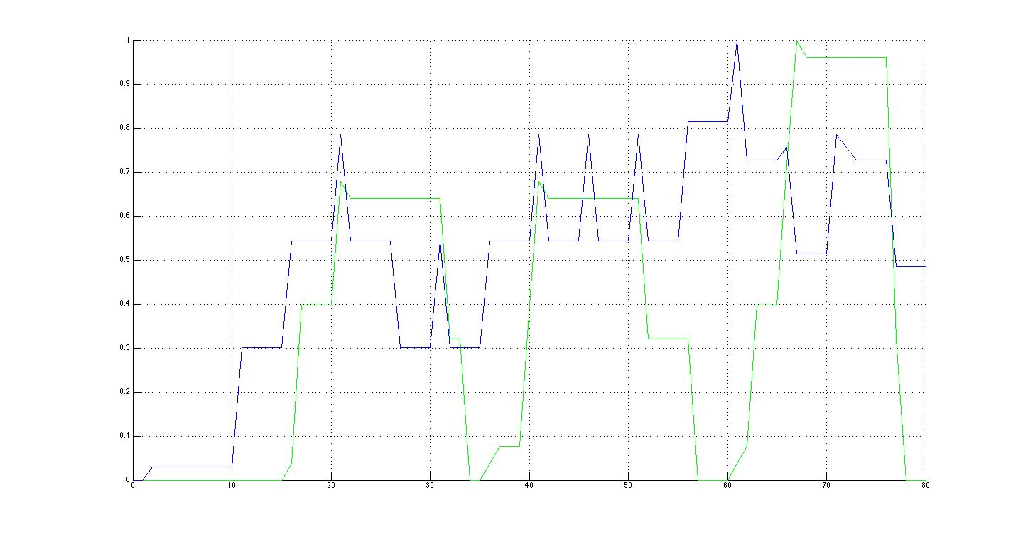
Bob and Alice Individual Workloads
Bob
Alice
Hello
Sad
Waving
Notes:
Bob is Blue and Alice is green.
At 10 - Bob can both increase his desire or wave(he decides to wave)
At 15 - bob waves, Alice decides to decreases apathy
At 20 - Bob goes to sad then increases desire
35 - bob waves again
40 - alice waves, bob doesn't see and goes sad
55 they see each other wave and begin talking
75 - conversation ends

Slide 65
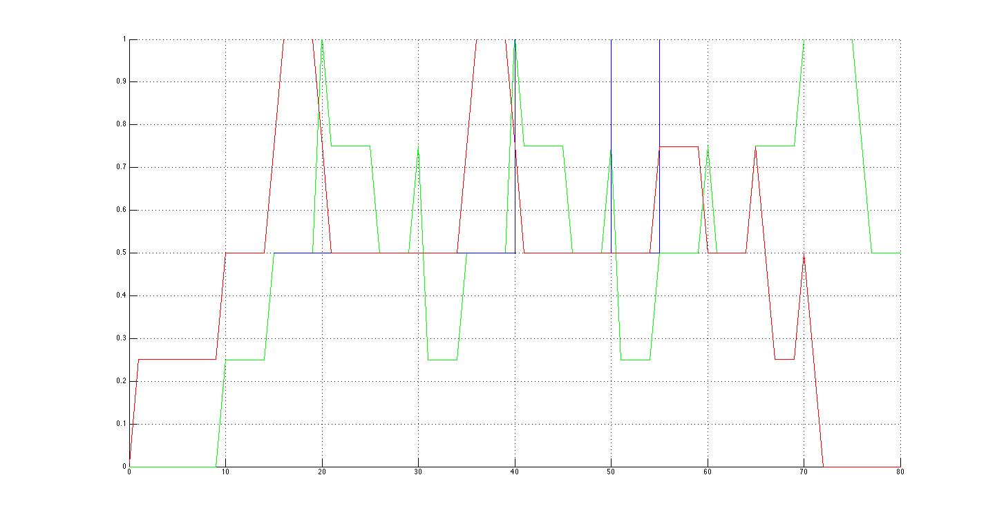
Bob and Alice Aggregate Workload
Cognitive
Temporal
Algorithmic

Slide 66
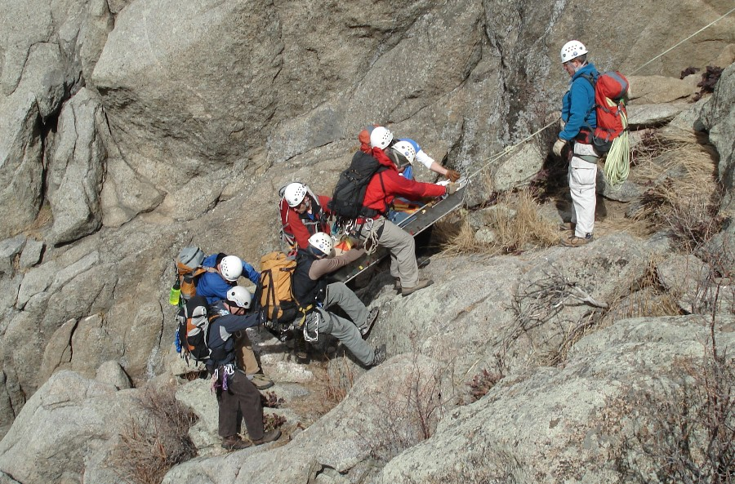
WiSAR

Slide 67
WiSAR Team Graph
Events
Mission Manager
V
Payload Operator
V
A
A
Payload
GUI
D
UAV
I
V
Incident Commander
Operator
GUI
V
V
V
UAV Operator
A
D
A
A
I
V
Notes:
Add visual and input connection on MM to Payload GUI. All of the actors is A and V only. Add DATA channel between Payload GUI and UAV Gui.
Add visual channel to UAV operator and UAV. Add data channels between GUIs and UAV.

Slide 68
WiSAR Team Graph
ABSTRACTION
Events
Mission Manager
V
Payload Operator
V
A
A
Payload
GUI
D
UAV
I
V
Incident Commander
Operator
GUI
V
V
V
UAV Operator
A
D
A
A
I
V
Notes:
Add visual and input connection on MM to Payload GUI. All of the actors is A and V only. Add DATA channel between Payload GUI and UAV Gui.
Add visual channel to UAV operator and UAV. Add data channels between GUIs and UAV.

Slide 69
WiSAR Model Statistics
Actor Name | Number of States | Number of Transitions
Parent Search | 5 | 19
Mission Manager | 16 | 56
Payload Operator | 13 | 45
UAV Operator | 13 | 80
Abstraction | 22 | 63

Slide 70
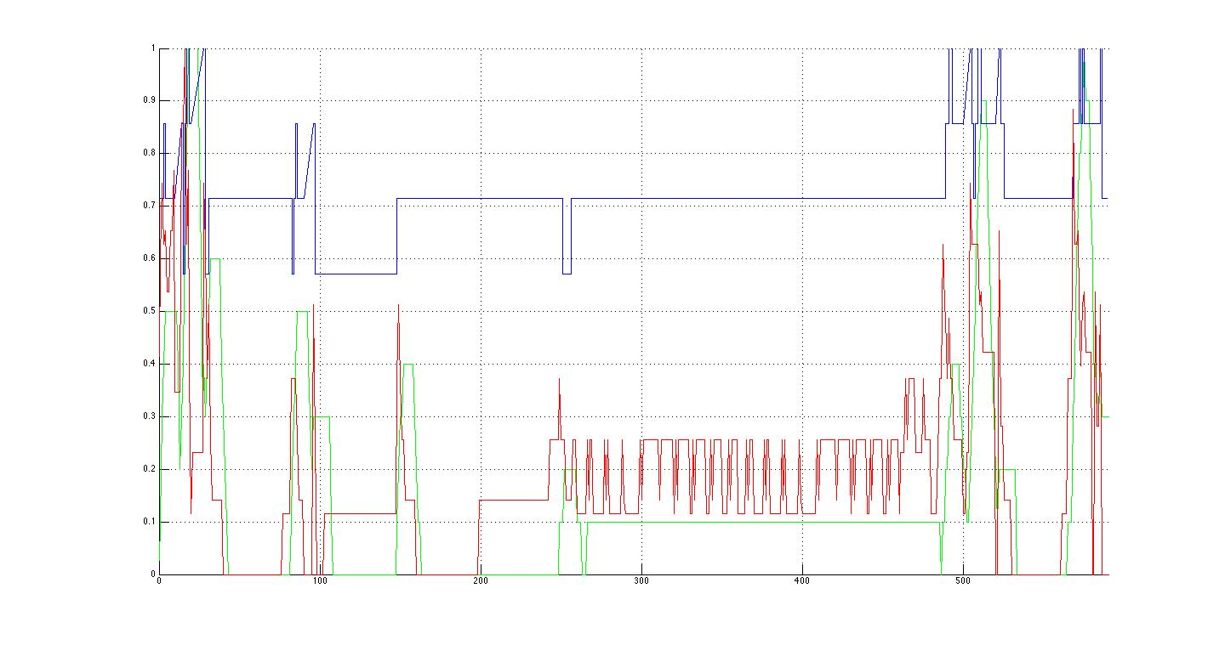
Results for Target Spotted
Cognitive
Temporal
Algorithmic
Land
Report
Flight plan
Monitoring
Notes:
First blue peak is the MM talking to the PS(Area of Interest)
The first green peak is the OP listening to the MM but he is quickly ignored as the MM realizes he needs more info from the PS(target description)
gap between early peaks(MM tells VO the target description first)
MM finally tells the OP the area to search resulting in second set of peaks.
large green peak around 160 - launching the UAV.
Medium green peaks at 260 - putting in the search area(it took awhile to enter, complicated flight plan)
green peaks in the middle are just controlling the UAV, alternating between gui control and direct control.
Blue peaks that come next are due to OP reporting flight completion.
high peak following is the MM reporting to the PS the search completion.
Green peak is landing
Final blue peak is the communication of the target sighting from the VO to the MM to the PS.

Slide 71
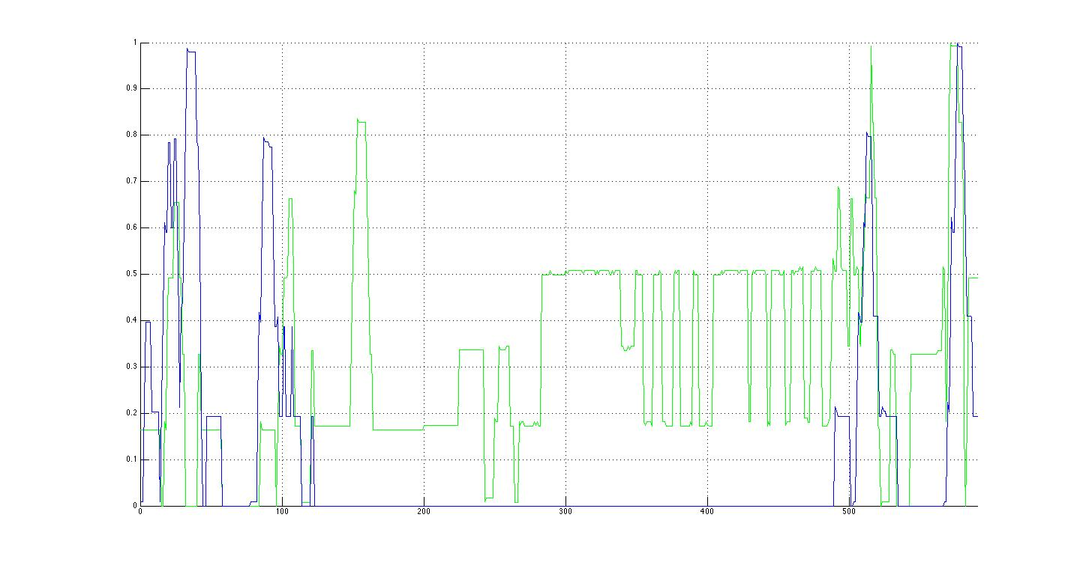
Sighting Per Actor
IC
OP

Slide 72
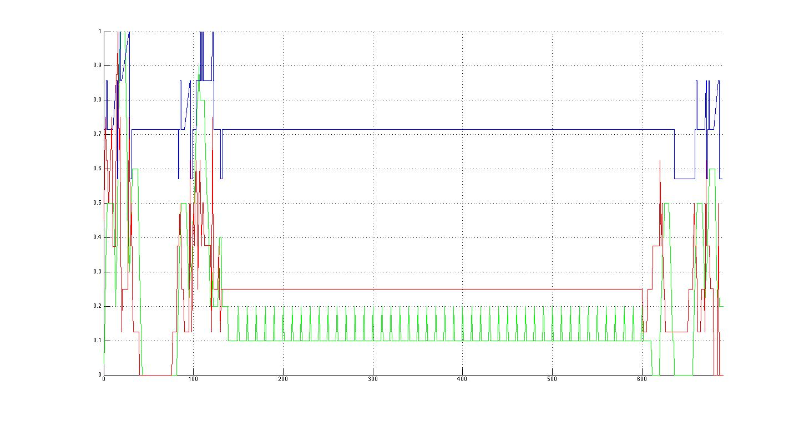
Results for Battery Failure
Cognitive
Temporal
Algorithmic
Crash
Battery Fail
Notes:
The first set of peaks are identical in reasoning to the Sighting. regular green peaks are monitoring and communicating with the GUI as he sets things up.
first green peak after is due to the operator realizing the battery is failing and trying to land it.
valley between green peaks - UAV crashes
second peak - reporting to the MM that the UAV crashed.
blue peak at the end - MM reporting to the PS that the search failed.

Slide 73
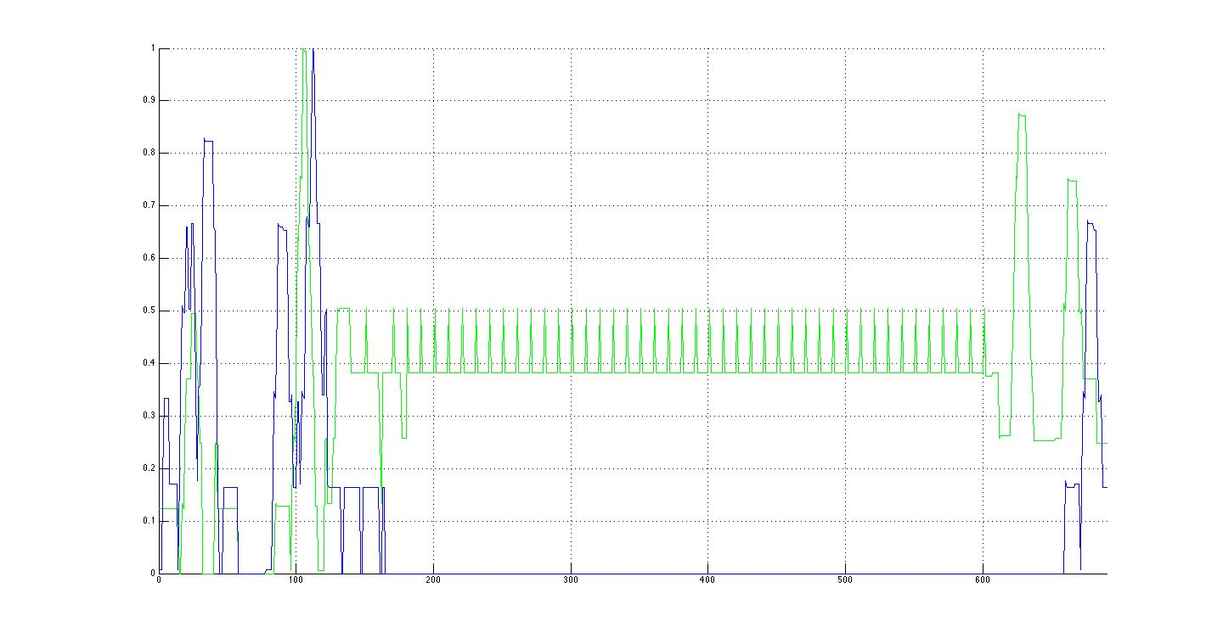
Crash Per Actor (MM and OP)
IC
OP

Slide 74
Conclusion and Future Work
Directed Team Graph for modeling UASs
Directed Role Graph for modeling actors
Discrete event simulation for time
Model checker to explore non-determinism
Temporal, cognitive, and algorithmic workload
WiSAR case study on two scenarios
Sensitivity study
Field study
More cognitive measures: parallel and multi-threaded

Slide 75
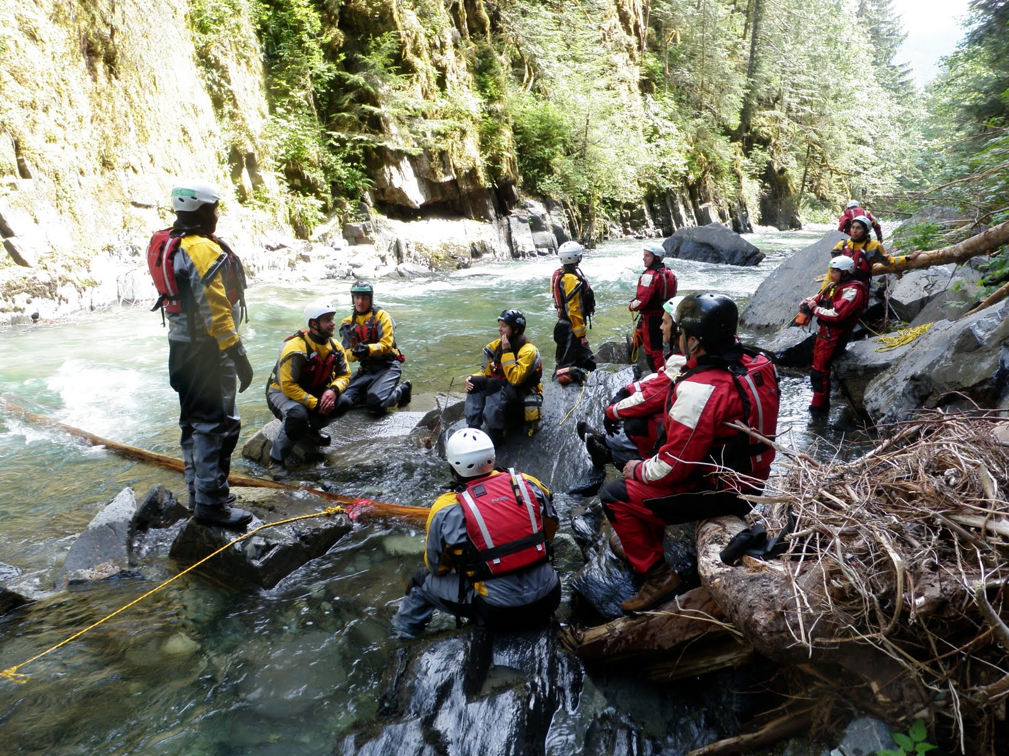
Questions?

